Slide 1
Request for Initial Assistive Technology Consultation

Slide 2
Changes to the Assistive Technology Service
Effort to truly build local capacity
Initial, standard service is a synchronous team discussion (face-to-face or virtual)
Discussion is facilitated by the TaC Coordinator
Action plans/notes are generated by the team members
Additional support is available as needed (and defined in action steps)
guidance on the implementation of existing supports and resources
trial of AT devices or software
AT training and implementation support for team members
observations by the AIU TaC Coordinator to gather additional information for revised action planning

Slide 3
Changes to the Assistive Technology Service
Streamlined request process
Online request made by liaison/meeting coordinator
Documentation is uploaded during the form completion (requires Google login)
Meeting participants and potential dates/times are provided by the LEA

Slide 4
Initial Meeting (anticipate 1 hour)
Meeting participants need to have DIRECT knowledge about the student and the day-to-day instruction, activities, materials, tasks, and environments that may be accommodated with assistive technology supports

Slide 5
Initial Meeting (anticipate 1 hour)
All meeting participants are REQUIRED to attend the initial meeting for its full duration. For that reason, the number of required participants should be kept to a minimum. Input from other (non-attending) team members can and should be provided via the meeting coordinator before and after the AT planning meeting.

Slide 6
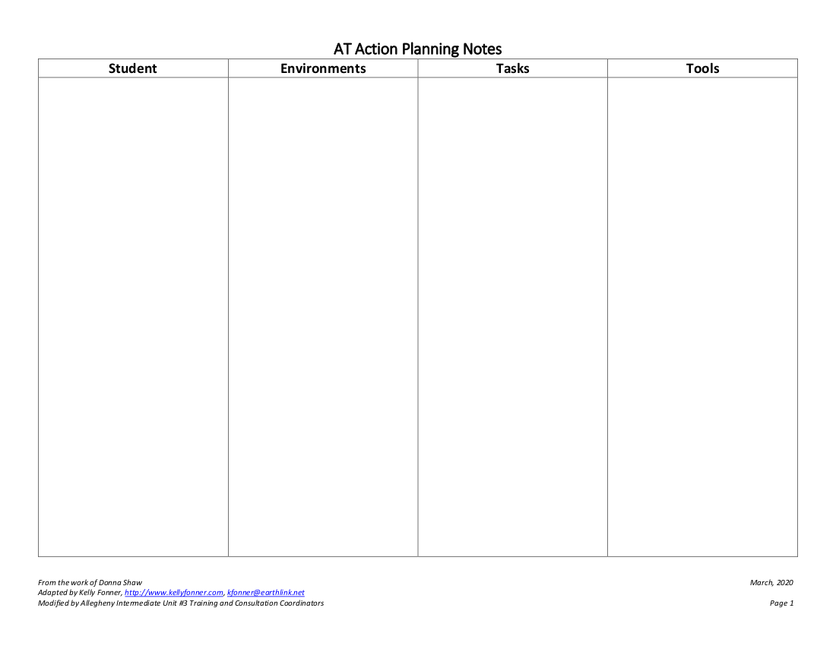
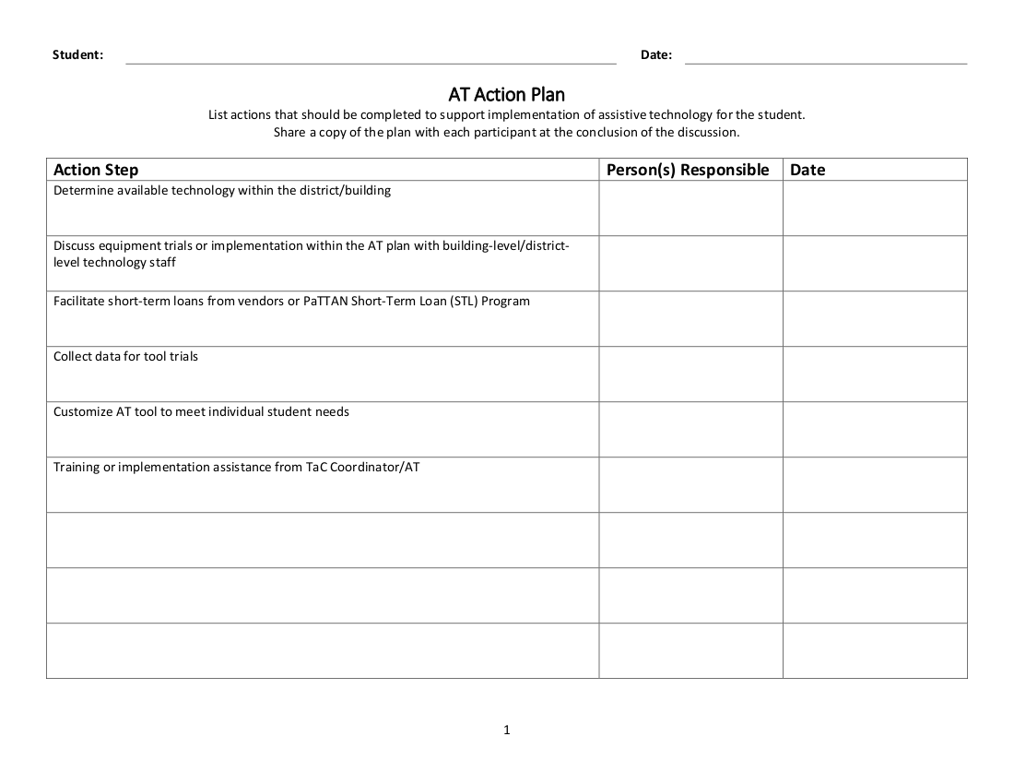
Notes and Action Planning Template

Slide 7
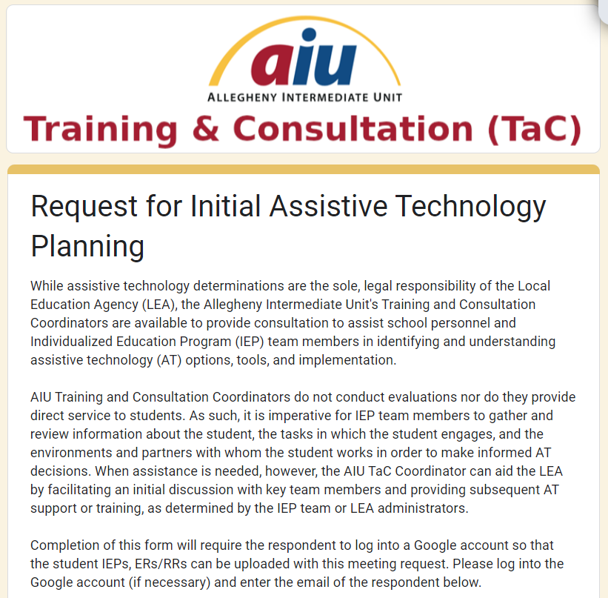
Links to Google Form
https://forms.gle/qSvuuF9k7E4jURXs9

Slide 8
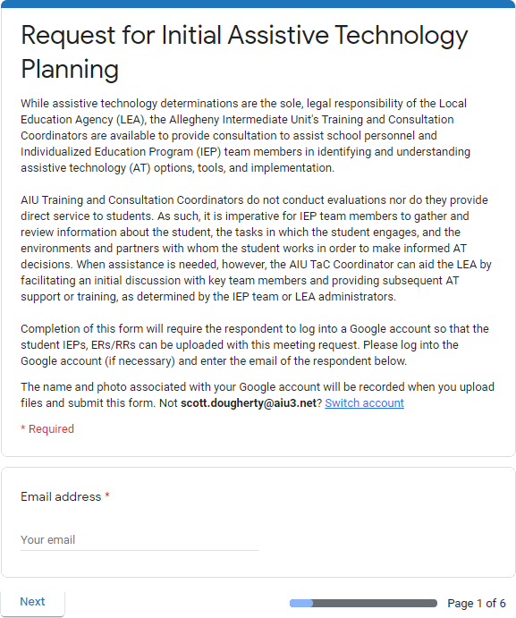
Section 1
Verify the Google Account that is currently logged in for Google Form’s use
Enter the email of the person completing the submission

Slide 9
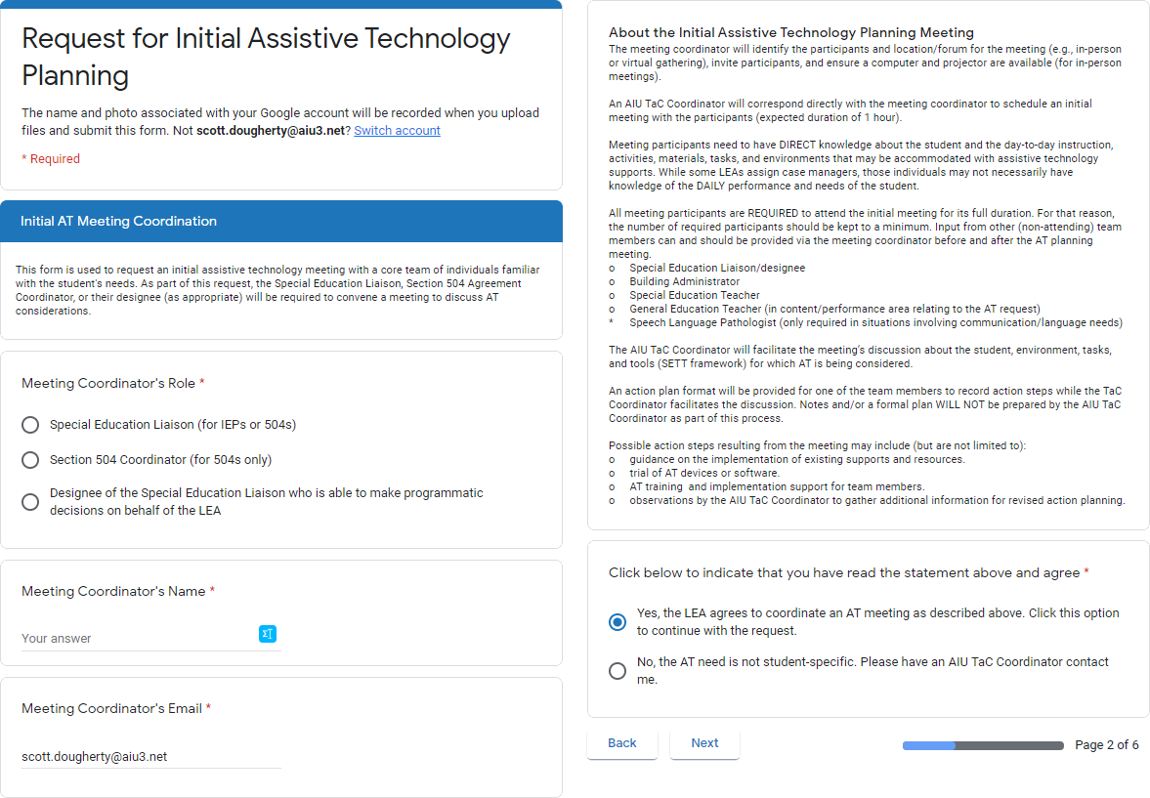
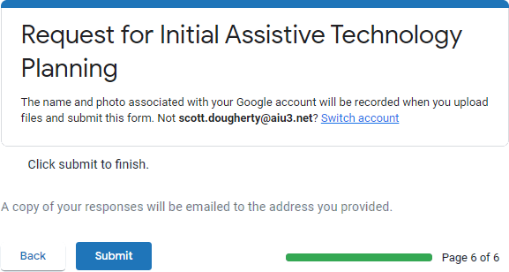
Section 2
Provides contact information for scheduling the initial meeting
Details the meeting parameters
Click Yes to continue the request
Click No to exit the form and submit contact information for follow-up

Slide 10
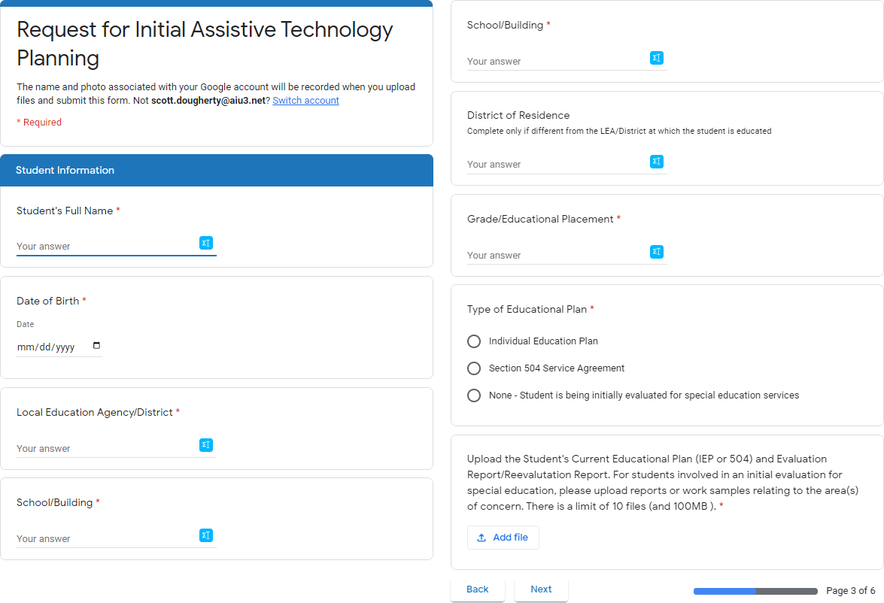
Section 3
Enter student information
Upload the ER/RR and IEP/504 (limit of 10 files and 100 MB)

Slide 11
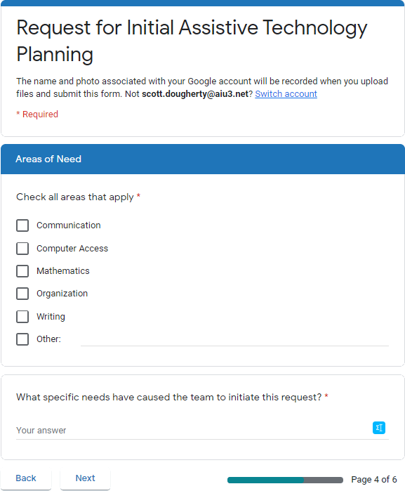
Section 4
Indicate the type(s) of AT supports to explore
Add additional, relevant information regarding the AT needs

Slide 12
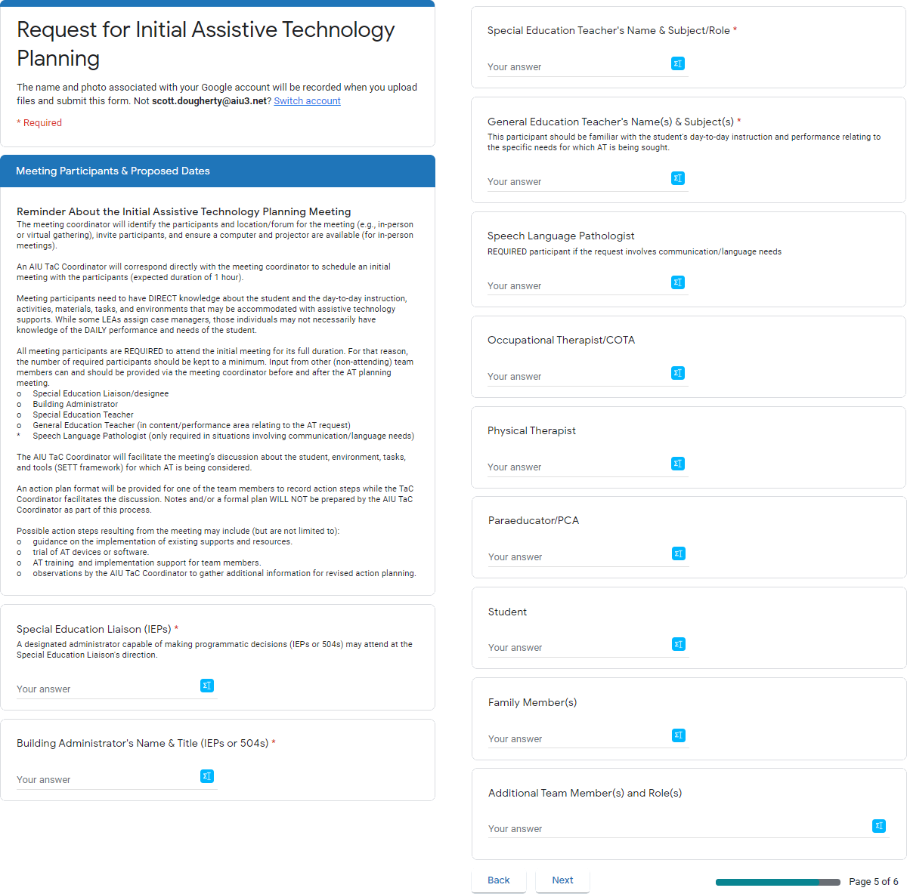
Section 5
Collects participants’ names
Special Education Liaison/designee
Building Administrator
Special Education Teacher
General Education Teacher (in content/performance area relating to the AT request)
Speech Language Pathologist (for communication/ language needs)

Slide 13
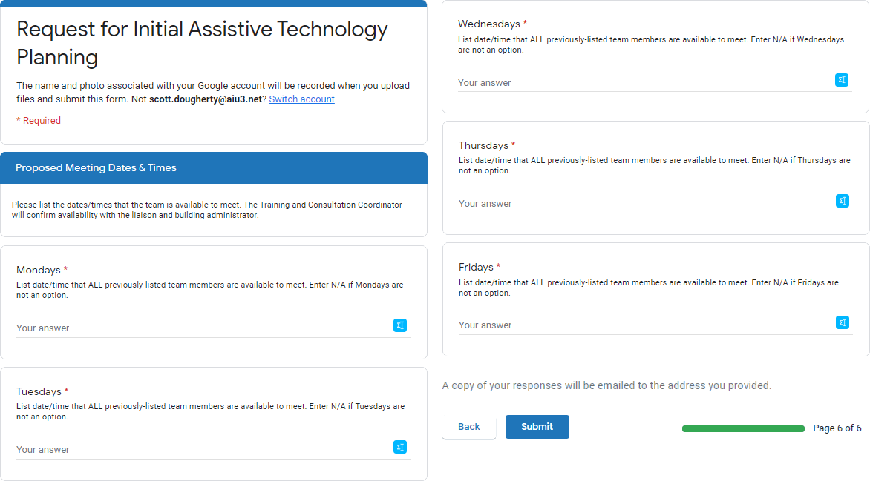
Section 6
Propose when previously named participants can meet each day of the week
Time range on a specific day of the week
“Any Tuesday between 12:45 and 3:20”
Specific date and time
“7:30 AM to 8:30 AM on 07/29/2020 or 08/12/2020”
“Unavailable”

Slide 14
Scheduling
Scott Dougherty will confirm materials are received and notify TaC Coordinator
TaC Coordinator will contact the LEA to schedule a meeting
LEA will ensure technology/room and participants are arranged for district staff

